Slide 1
Big Data Processing
Jiaul Paik
Lecture 13

Slide 2
Topics I am Going to Cover

Slide 3
Map-reduce Algorithm Design
  Pairs and Stripes
  Combiner
Fast Big Data Processing with Spark

Slide 4
Pairs and Stripes

Slide 5
Problem: Word co-occurrence
Find the number of times two words appear together in a collection of documents
Applications:
  Finding related words
  Computing word embedding in NLP
  Machine Translation
John and harry are friends
John and harry are classmates
(harry john), 2
(friends john), 1
(classmates john), 1
(classmates harry), 1

Slide 6
Map-reduce Algorithm (Simple)
mapper
reducer
class Reducer
method Reduce(pair p; counts [c1; c2; : : :])
s = 0
for all count c in [c1; c2; : : :] do
s = s + c
Emit(pair p; count s)
class Mapper
method Map(docid a; doc d)
for all term w in doc d do
for all term u (≠ w) in d do
(p,q) = dictionaryOrder(w,u)
Emit(pair (p, q); count 1)

Slide 7
What is wrong with it?
class Mapper
method Map(docid a; doc d)
for all term w in doc d do
for all term u (≠ w) in d do
(p,q) = dictionaryOrder(w,u)
Emit(pair (p, q); count 1)
Example Documents
John and harry are friends
John and harry are classmates
John and harry are friends
John and harry are classmates
class Reducer
method Reduce(pair p; counts [c1; c2; : : :])
s = 0
for all count c in [c1; c2; : : :] do
s = s + c
Emit(pair p; count s)

Slide 8
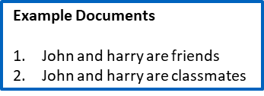
Better Map-reduce Algorithm
class Mapper
method Map(docid a; doc d)
for all term w in doc d do
H = new AssociativeArray
for all term u (≠ w) in d do
H(u) = H(u) + 1 .
Emit(Term w; Stripe H)

Slide 9
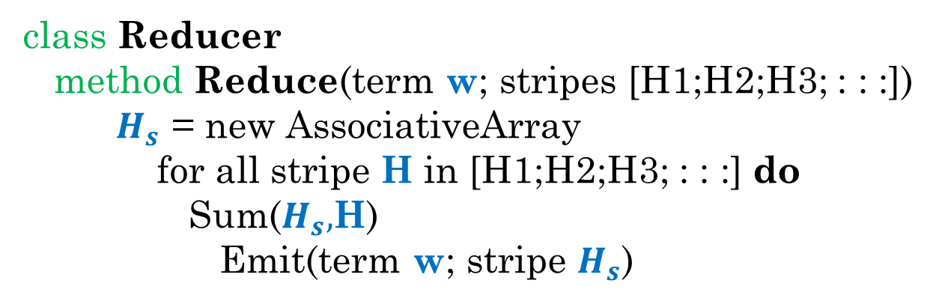
Better Map-reduce Algorithm
class Mapper
method Map(docid a; doc d)
for all term w in doc d do
H = new AssociativeArray
for all term u in d do
H(u) = H(u) + 1 .
Emit(Term w; Stripe H)
class Reducer
method Reduce(term w; stripes [H1;H2;H3; : : :])
$H_{s}$ = new AssociativeArray
for all stripe H in [H1;H2;H3; : : :] do
Sum($H_{s},$H)
Emit(term w; stripe $H_{s}$)

Slide 10
Use of Combiner

Slide 11
Role of combiner
Combiners are mini-reducers
Reduces data from mappers before they are shuffled through the network

Slide 12
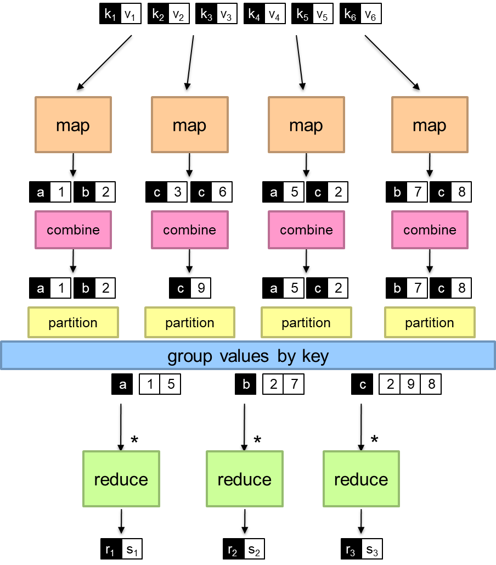
Splitting job
Intermediate combining
Final combining

Slide 13
Problem: Computing Mean
A shop has a database which contains the customer names and the time spent by the customer in the shop in each visit. Find the average time spent by each customer in the shop.
Name | Time spent on each visit
amar | 10
amar | 20
rakesh | 15
rakesh | 25
sanjib | 7
rakesh | 25
amar | 30
sony | 20
jiban | 15

Slide 14
Computing mean: Use of combiner
class Reducer
method Reduce(string t; pairs [(s1; c1); (s2; c2) : : :])
sum = 0
count = 0
for all pair (s; c) in pairs [(s1; c1); (s2; c2) : : :] do
sum = sum + s
count = count + c
avg = sum/count
Emit(string t; integer avg)
class Mapper
method Map(string t; integer r)
Emit(string t; pair (r, 1))
class Combiner
method Combine(string t; pairs [(s1; c1); (s2; c2) : : :])
sum = 0
count = 0
for all pair (s; c) in pairs [(s1; c1); (s2; c2) : : :] do
sum = sum + s
count = count + c
Emit(string t; pair (sum, count))

Slide 15
Combiner: Warning!
class Combiner
method Combine(string t; integers [r1; r2; : : :])
sum = 0
count = 0
for all integer r in integers [r1; r2; : : :] do
sum = sum + r
count = count + 1
Emit(string t; pair (sum, count))
class Mapper
method Map(string t; integer r)
Emit(string t; integer r)
class Reducer
method Reduce(string t; pairs [(s1; c1); (s2; c2) : : :])
sum = 0
count = 0
for all pair (s; c) in pairs [(s1; c1); (s2; c2) : : :] do
sum = sum + s
count = count + c
avg = sum/count
Emit(string t; integer avg)
Combiner output must match with mapper output

